Slide 1
DAVID KOLB’S LEARNING CYCLE (David kolb on-line pdf)
Learning Style Preferences
HONEY & MUMFORD
(www. hrdevelopment.co.nz)

Slide 2
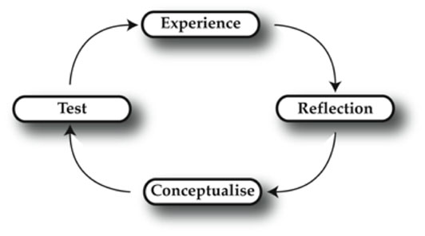
Using the cycle in real life

Slide 3
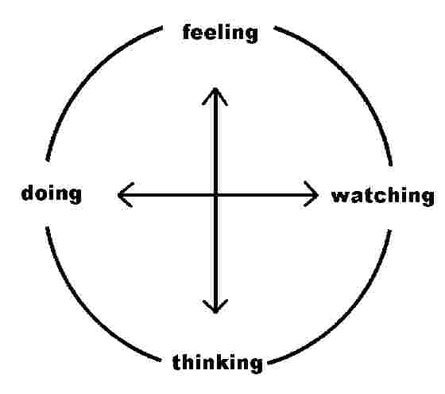
Kolb’s theory is Based on opposites based on Myers Briggs typology.

Slide 4
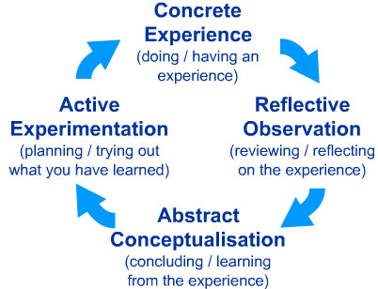
Kolb’s learning cycle

Slide 5
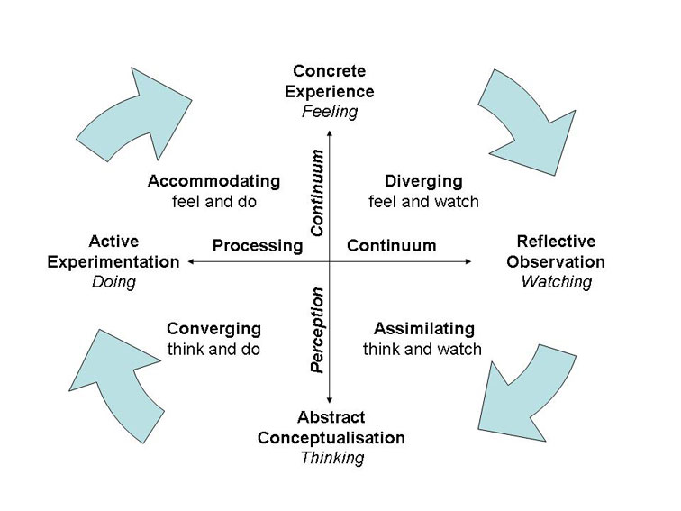
LEARNING STYLE PREFERENCES HONEY &MUMFORD
ACTIVIST
REFLECTOR
PRAGMATIST
PRAGMATIST
THEORIST

Slide 6
LEARNING STYLES
Diverging/Reflector (CE/RO)
Assimilating/ Theorist (AC/RO)
Converging/ Pragmatist (AC/AE)
Accommodating/Activist (CE/AE)

Slide 7
ACTIVISTS
'Having an Experience' (stage 1), and Activists (style 1): 'here and now', gregarious, seek challenge and immediate experience, open-minded, bored with implementation.

Slide 8
REFLECTORS
'Reviewing the Experience' (stage 2) and Reflectors (style 2): 'stand back', gather data, ponder and analyse, delay reaching conclusions, listen before speaking, thoughtful.

Slide 9
THEORISTS
'Concluding from the Experience' (stage 3) and Theorists (style 3): think things through in logical steps, assimilate disparate facts into coherent theories, rationally objective, reject subjectivity and flippancy.

Slide 10
PRAGMATISTS
'Planning the next steps' (stage 4) and Pragmatists (style 4): seek and try out new ideas, practical, down-to-earth, enjoy problem solving and decision-making quickly, bored with long discussions.

